Slide 1
Week 3 (Aug 19 – Aug 23)

Slide 2
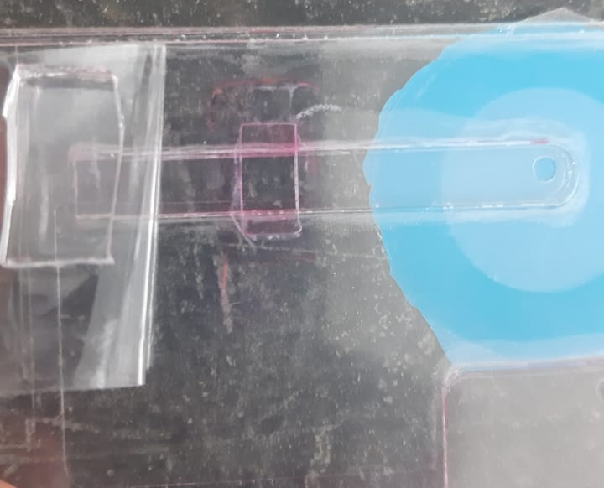
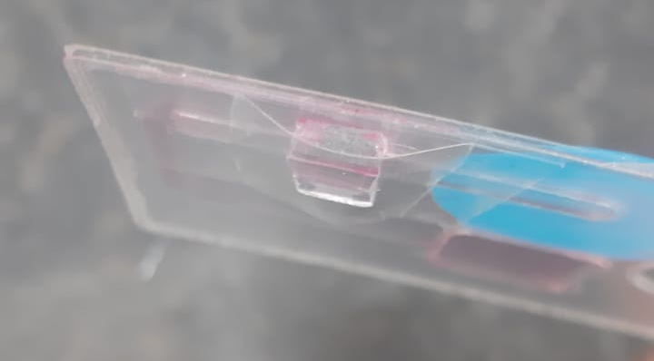
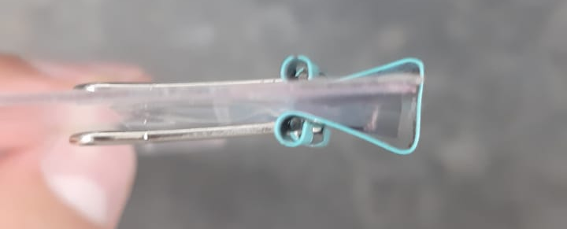

Slide 3
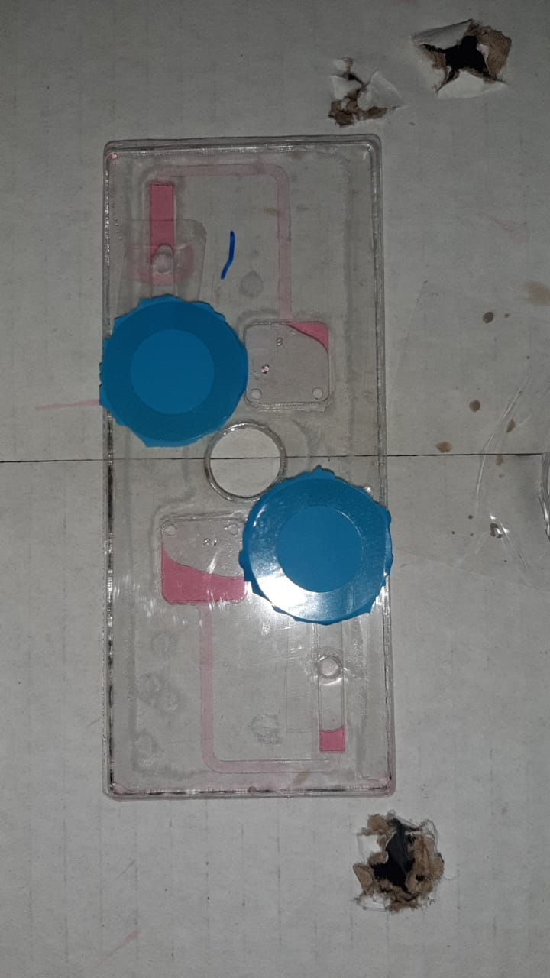
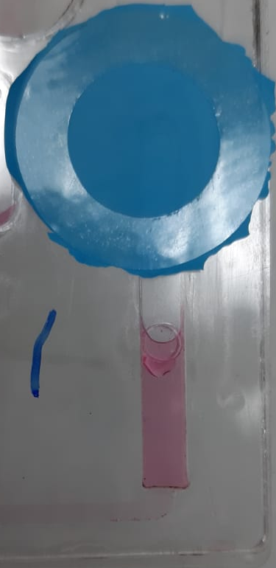
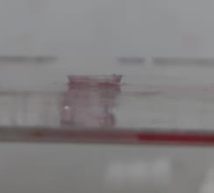

Slide 4
Conclusions
Regarding on how the substrate is placed, its compliance will cause leakage if enough pressure is held at enough time.
Placing the substrate inside is desirable.
Thicker pieces of PDMS are easier to handle, so a thicker middle layer would be required.
If a thin piece is wanted, better ways of performing the chemical reactions are needed (depth of beakers can make it hard to retrieve the PDMS piece with tweezers).

Slide 5
Next actions
Find a way to seal/close the device from the outside on all edges to prevent leakages while making it reusable.
Try chemical reactions on a Petri dish with a thin piece to evaluate feasibility and repeatability.

Slide 6
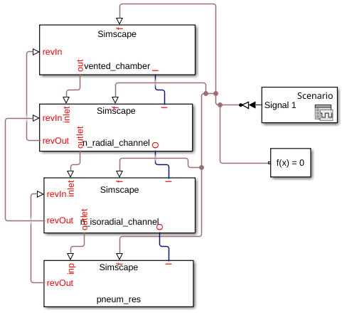
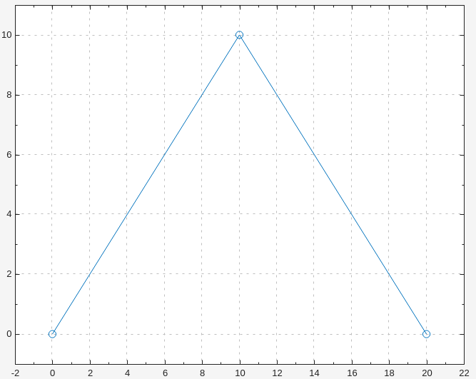
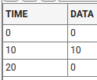
MATLAB Simulation

Slide 7
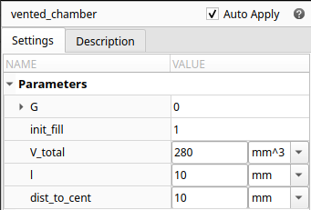
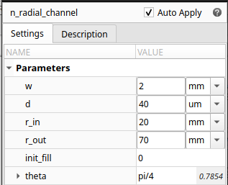
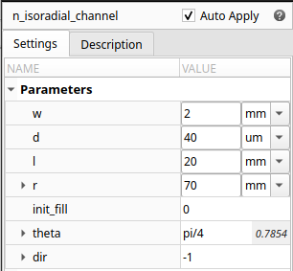
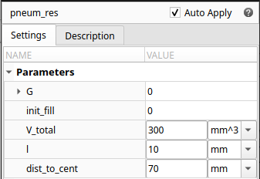

Slide 8
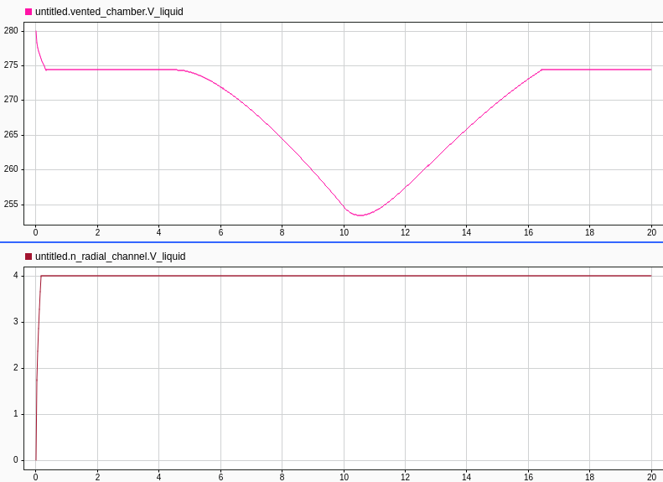

Slide 9
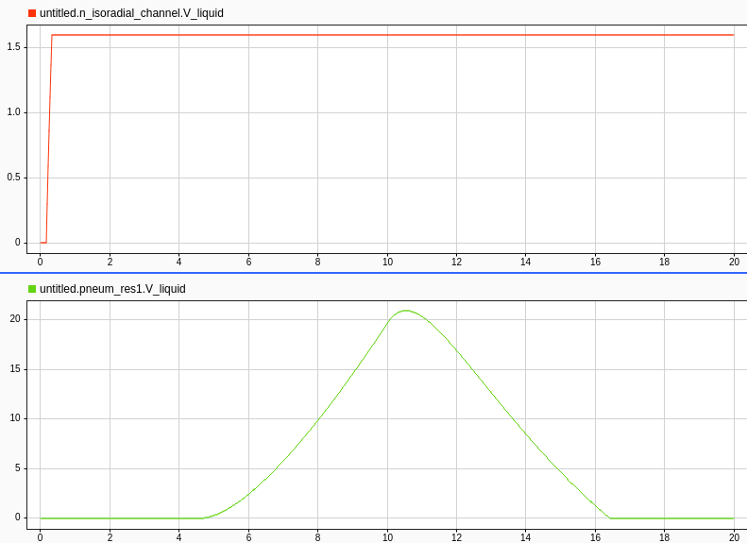

Slide 10
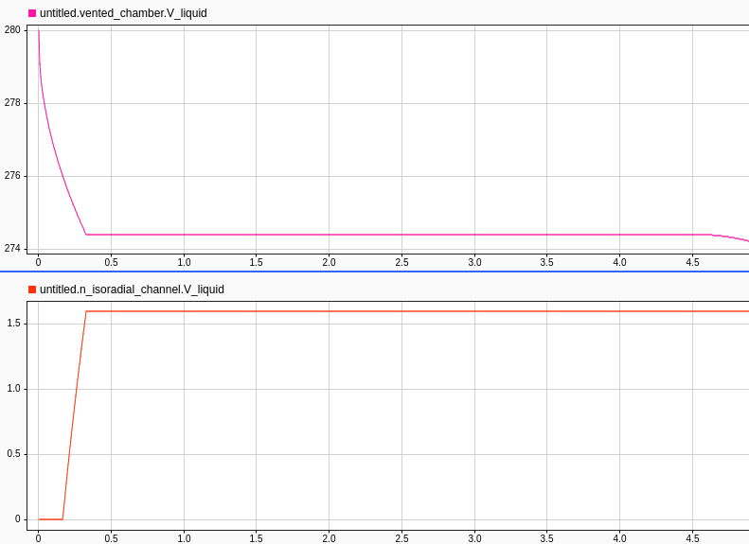

Slide 11
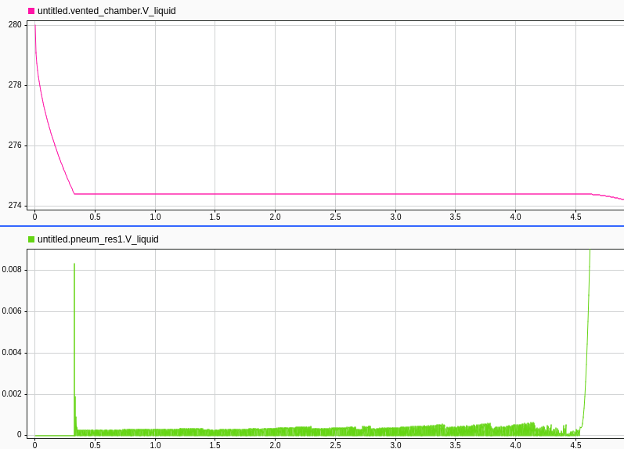

Slide 12
